Slide 1
Multi-threading and Free RTOS using Arduino IDE in ESP32 and ESP8266
Inter-Disciplinary center for Smart Technologies
Technion CS

Slide 2
Subjects in this presentation
1
2
3
4
Part 1 – Introduction to Free RTOS
Part 2 – When to use Free RTOS
Part 3 – Communication between tasks
Part 4 – things to watch out for in Free RTOS

Slide 3
What is a thread?
a thread of execution is a process that runs upon one of the cores provided in the unit (either it be a microcontroller unit or a full-fledged Intel/Amd CPU).
In ESP32 and other microcontrollers, we can use an operating system for handling “threads”, it is called FreeRTOS.

Slide 4
Why do we use multiple threads?
Multi-threading is useful when wanting to preform multiple tasks at the same time, the operating system provides a scheduler which can give the feeling of multiple processes running at the same time. When wanting to preform multiple checks that have *blocking code, multi-threading can be a very efficient tool to perform both tasks without much code overhead.
Notes:
A blocking code is a code that stops the program from continuing its execution until a specific event happens.
- Check Scheduling and Time Measurement using ESP32 in Arduino IDE in the knowledge bank for more information.

Slide 5
What is an RTOS?
An RTOS, or a Real Time Operating System, is basically an operating system which includes a scheduler for executing different tasks in a predictable manner.
Traditional RTOS’s achieve this predictability by allowing the user to assign each thread of execution a priority.

Slide 6
What is FreeRTOS?
FreeRTOS is an RTOS which is designed to run on microcontrollers such as ESP32 and ESP8266.
Unlike regular UNIX threads, “threads” in FreeRTOS are called tasks, FreeRTOS provides the core real time scheduling functionality, inter-task communication, timing and synchronization primitives only.

Slide 7
Example 1:
We are interested in designing an ESP32 with a button, a beeper and a led, when pressing the button the beeper plays a song and the led starts fading on and off.
We have three functions:
playSong(); // plays a song, takes 1 minute to complete.
fadeLed(); //fades the led light for 1 minute.
checkButton(); //checks if the button was pressed, returns true if pressed and false if not

Slide 8
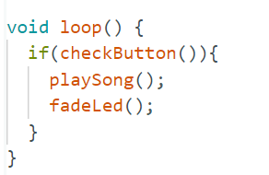
Example 1 (continued):
As said, we are interested in playing the song and fading the led light at the same time, if we write this code:
The problem immediately shows up, if the button is pressed we play the song for 1 minute then we fade, which is not what we wanted, using timers won’t help all that much since the functions are already written and we don’t want to edit them.

Slide 9
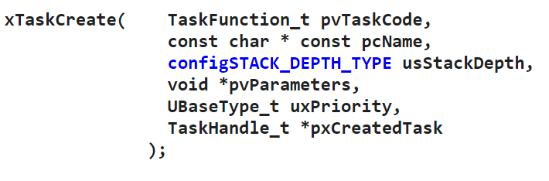
Example 1 (continued):
Solution:
Create a task for each thread and wait for both of them to finish.
But how do we do that?
Definition 1:

Slide 10
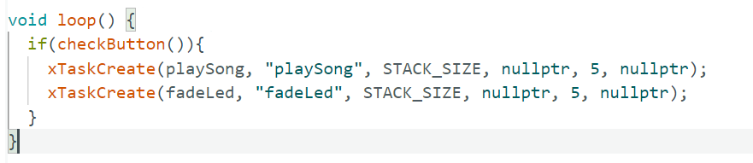

xTaskCreate(…);
The function XTaskCreate looks scary, but it is really simple.
An example of how we would use it in the example:
Where STACK_SIZE is 2048:

Slide 11
xTaskCreate(…);
Explanation for some of the parameters (for the full explanation a link is provided in the presentation notes, though we won’t use many of the parameters).
pvTaskCode is simply a pointer to the function, you can pass the function name as it is.
Note that the entry function should be in this form:
function_name(void* params){
// code
}
Notes:
More on xTaskCreate: https://www.freertos.org/a00125.html

Slide 12
xTaskCreate(…);
Third parameter (usStackDepth) limits how much stack the task (thread) has.
Fourth parameter (pvParameters) is a pointer to a parameter that we want to pass to the thread, this is why the entry function has the *params parameter, the fourth parameter in xTaskCreate is passed there.
The last parameter (pxCreatedTask) is a pointer to the task handle, basically it is used to interact with the task (either kill it or suspend it or…)
xTaskCreate updates the value of the handle to “point” at the task.

Slide 13
Important notes on xTaskCreate(…);
When a thread is done, it cannot return as usual. This would crash the whole ESP chip and there is no easy way to debug it. Rather, the task should either kill itself by using vTaskDelete(nullptr);
Make sure that STACK_SIZE is sufficient, otherwise unexpected behaviour may occur.
FreeRTOS provides priorities for tasks, be careful when using this, it may starve some important task and there is no easy way to know which task is starved (for example a check button task is a high priority task because we cannot miss clicks).

Slide 14
vTaskDelete();
Used for deleting tasks.
If the task wants to delete itself:
vTaskDelete(nullptr);
If another task wants to delete the task it should have a handle, and then pass it to vTaskDelete:
vTaskDelete(handle);
Notes:
For more on vTaskDelete() : https://www.freertos.org/a00126.html

Slide 15
Important notes on vTaskDelete(…);
Be careful that the task is responsible for cleaning allocated memory before killing itself, any memory that hasn’t been freed will remain in use.
It is preferable that a task kills itself internally, from experience, a task deleting another task is prone to bugs and crashes.. The best way is to delete internally. If a parent task wants to delete the child it should pass a flag telling the child to delete itself, by using communication methods (more on that later).
Notes:
For more on vTaskDelete() : https://www.freertos.org/a00126.html

Slide 16
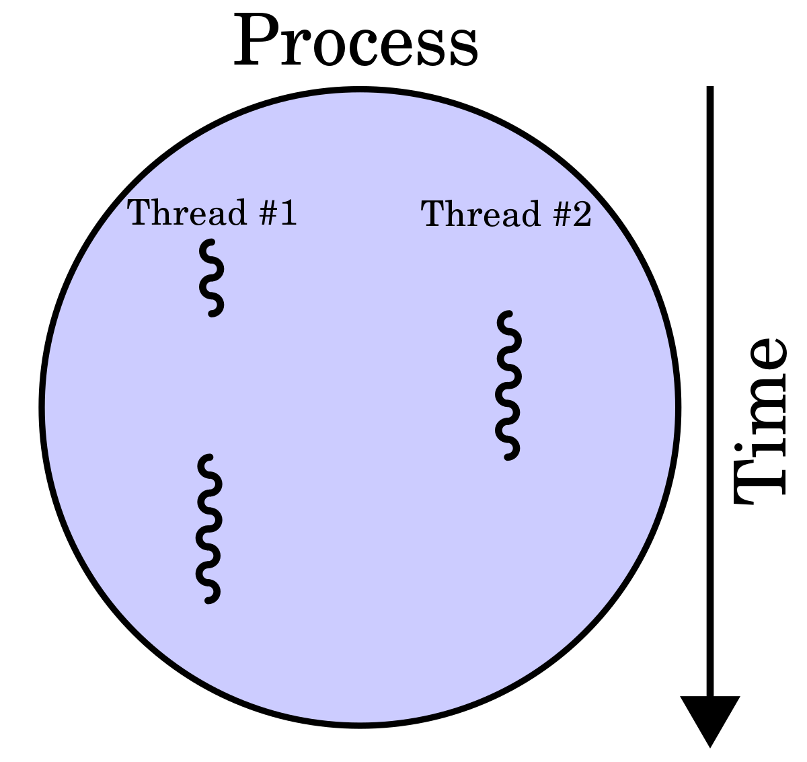
Although multi-tasking can be really useful, it isn’t always the best tool to use. In this part we will expand more on when to use multi-tasks and when not to use it.

Slide 17
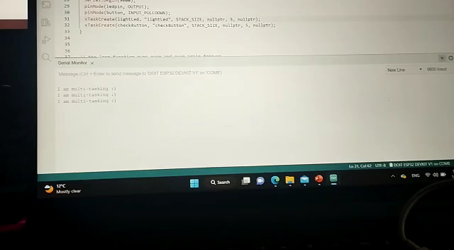
Example 2 – simple button led light:
We are interested in checking a button and lighting a led light when the button is clicked, and at the same time, printing every second to the terminal. A video showing what we expect:

Slide 18
Example 2 – cont
Notice that we have 3 different tasks:
Checking the button.
Lighting the led.
Printing to screen.
In this case, 2 solutions can be used, a software timer or tasks, we are going to use tasks.

Slide 19
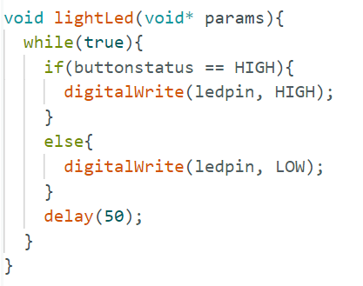
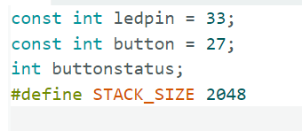
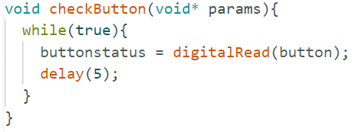
Example 2 – The code
Globals:

Slide 20
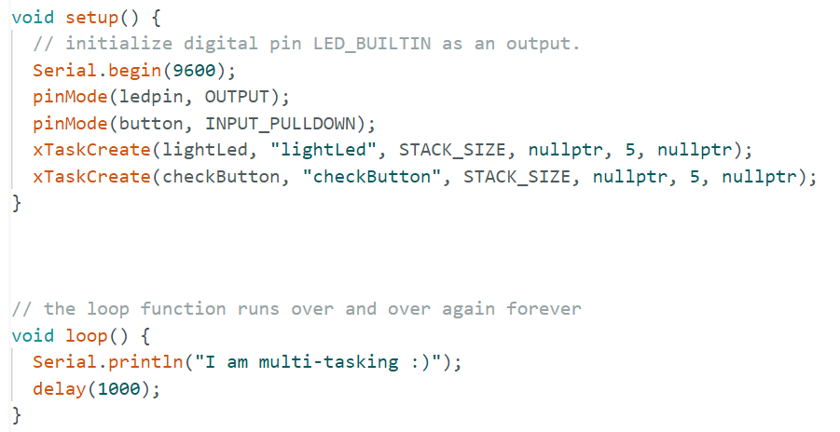
Example 2 – The code
Notes:
The code for this can be found in Github, the link is at the end of the presentation.

Slide 21
Could we have implemented example 2 without Free RTOS?
It is relatively simple to do what we did in example 2 without the use of Free RTOS, and only by using primitive timers that give some time to the led and then some time to check the button.

Slide 22
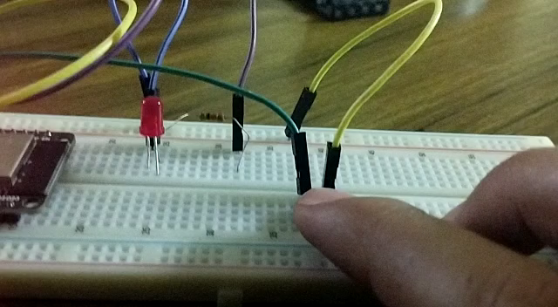
Example 3 – fading led
We are now interested in fading the light, but only when the button is clicked! if it is not clicked then hold.
This becomes a challenge using timers, but is a breeze using tasks.
Notes:
Code example in Github.

Slide 23
Could we have implemented example 3 without using Free RTOS?
The answer is still yes, though the internal code of checking the button and lighting the led has to be much more complicated, mainly because we can’t remain too long in the light led function or else we will miss the user click on the button.
We notice that as we complicate what we need to do the use of timers begins to look like a bad choice.

Slide 24
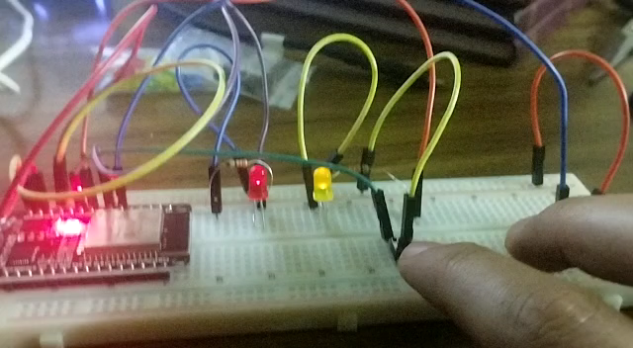
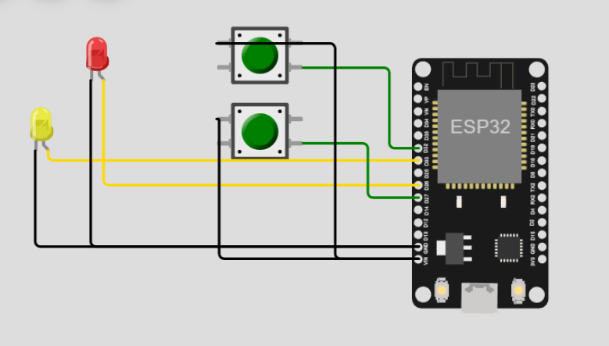
Exampel 4 – multiple fading leds
Raising the level of complexity, it becomes apparent why the use of tasks is a necessity: Link to simulator

Slide 25
Could we have implemented example 4 without using Free RTOS?
To implement the fourth example without using Free RTOS we would need intricate timer tricks in order to implement the same thing that we would implement easily using tasks.
And much more..
When talking about large projects, lightings Led lights is not really the tasks, we would need to get a WiFi signal and at the same time check a temperature sensor for change and at the same time use a button to… the idea is clear.

Slide 26
In short
Using Free RTOS becomes a good choice when multiple tasks cannot be done by using simple timer tricks.
As can be seen, we haven’t mentioned Free RTOS as a tool to achieve more performance (as is usually taught when mentioning multi-threading), because that is not what we should use it for in ESP32, rather, it should be used as a way to make complicated ideas easier to write as code.

Slide 27
Global variables
Global variables can be used to communicate between tasks since they reside in the static section of the program, and thus all tasks have access to them.
Generally, global variables are not a good way to communicate between threads due to them introducing bugs that are hard to detect, however, for the purposes and scale of the course, they are more than enough.

Slide 28
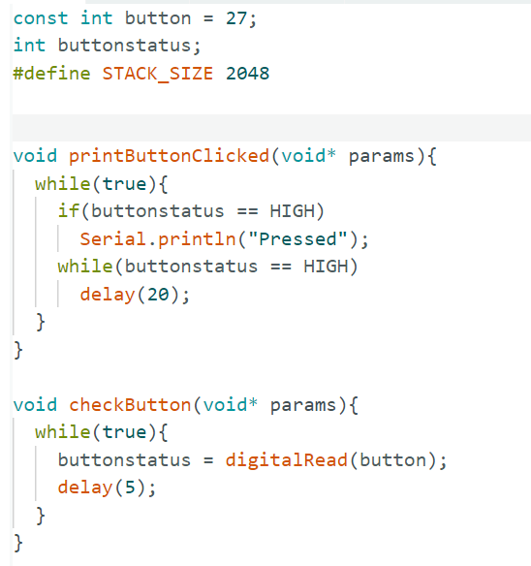
How do we use global variables?
Assume we have two tasks, one reads a button input and the other prints “pressed” when the button is pressed, we need a communication scheme between the two tasks, we do this by using a global variable called buttonStatus, that is set high by the first task when the button is pressed.
Task 2
Task 1

Slide 29
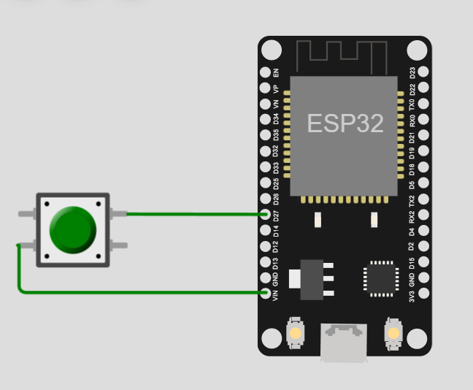
How do we use global variables? – cont
The first task is simple, it checks the button and updates the buttonStatus global variable, the second task keeps checking if buttonStatus is set, if it is, task 2 prints to serial.
The first task is simple, it checks the button and updates the buttonStatus global variable, the second task keeps checking if buttonStatus is set, if it is, task 2 prints to serial.
Task 2
Link for simulator:
Task 1

Slide 30
In the previous example, we didn’t use any mutexes or synchronization schemes, why?
When to use synchronization schemes?
Generally, when two tasks or more communicate using a global variable, a synchronization scheme is needed when all the tasks are writing to the variable, a lot of problems can occur when a context switch occurs during the writing of two tasks to the same variable.

Slide 31
When to use synchronization schemes? – cont
A good rule of thumb is to use synchronization schemes when possible, even more so when the variable at hand is very important and it’s correctness is of utmost importance.
In our example, task 1 writes to the value and task 2 reads, so we can skip using a mutex.
But for the examples sake, we will also show an example with a mutex:

Slide 32
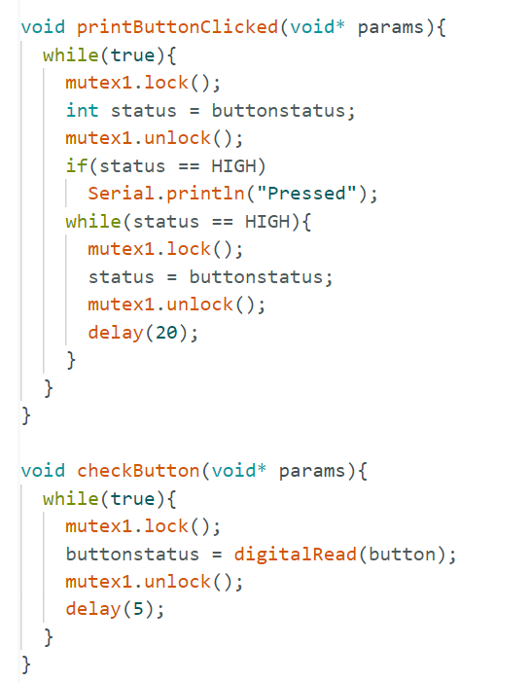
Example : using a mutex
We can see the code got a bit more complicated, and when speaking about more complicated codes deadlocks start to happen, thus one must be very careful when using mutexes.
Link in the simulator.
Notes:
The simulator is a bit slower, so you need to hold the press on the button for it to work. This is not the case with a real ESP32.

Slide 33
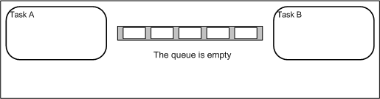
Queues
Another way to achieve inter-task communication is to use queues, Free RTOS provides a full interface for queues, they are a bit more complicated than global variables but are much safer.

Slide 34
Global variables vs Queues
Put simply, global variables are much easier, while queues are much safer, though there is an overhead for learning how to use queues as they using them is not as simple as pushing and popping.
For more information on queues, the full document can be found here:
FreeRTOS - FreeRTOS queue API functions, including source code functions to create queues, send messages on queues, receive messages on queues, peek queues, use queues in interrupts.

Slide 35
1) Time concerns
We note that, although Free RTOS enables us to create as many tasks as we desire, ESP32, unlike more powerful chips, is a 2-core chip, meaning that it can only run 2 tasks at a time, moreover, one of the cores is used for the management WiFi, Bluetooth and Serial communication, meaning that tasks have overhead, so when creating tasks, think twice if the tasks at hand can be done synchronously without the use of multi-threading.

Slide 36
2) Space concerns
When creating a task, we pass stack size parameter to xTaskCreate(), be very careful not to overflow the stack (either with recursive calls or arrays), if a big array or a recursive function are needed, then do this in the main thread.
From experience, there is no good way to really know that the stack overflowing is what caused the crash, so try to avoid these kind of bugs as much as possible.

Slide 37
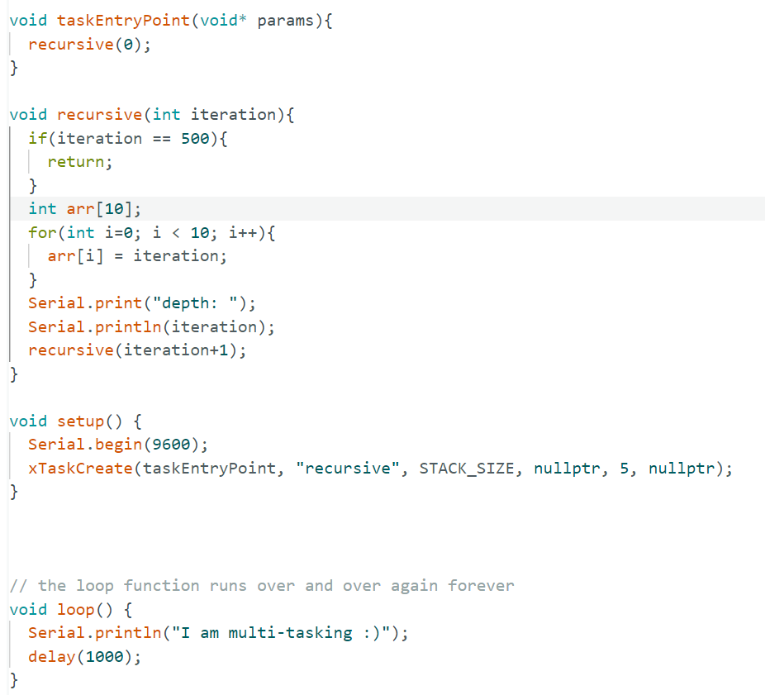
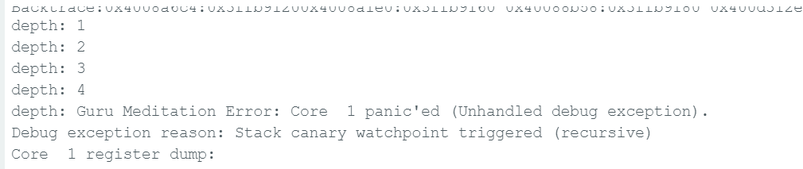
2) Space concerns - cont
This code runs a recursion, esp32 fails on the 4th call.

Slide 38
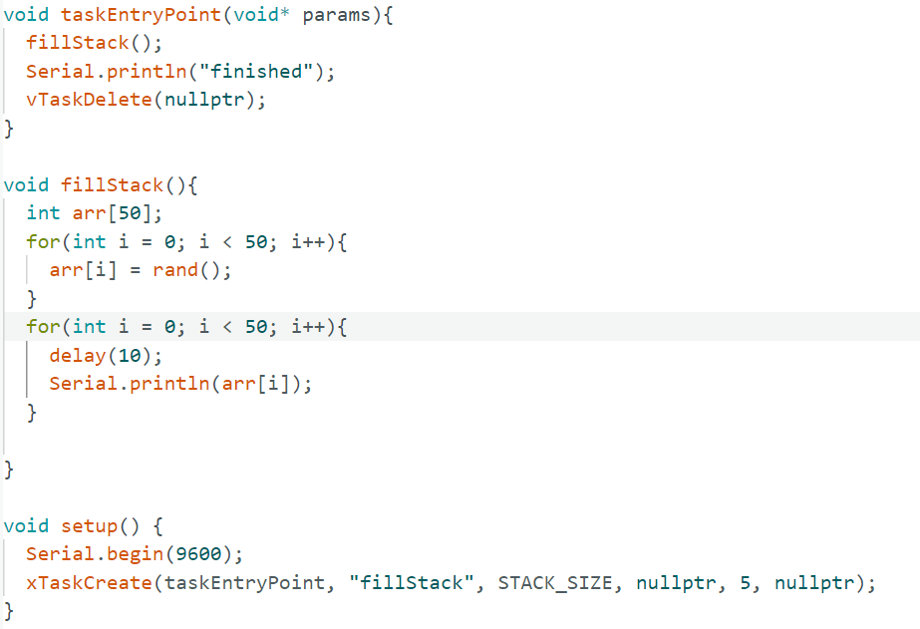
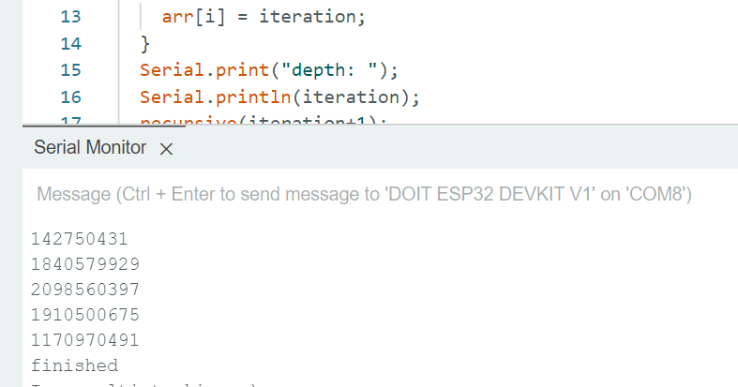
2) Cont - Another example for how sensitive task space allocation is:
Code allocates an array with 50 elements.
Works fine.

Slide 39
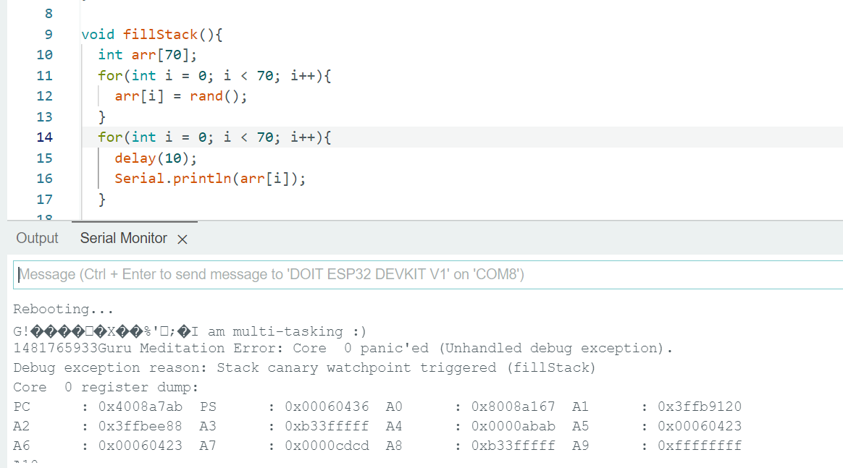
On 70 elements, the task crashes the chip:
Apparently, there is no way to debug this, so be very careful.

Slide 40
3) Scheduling concerns
Remember from OS course, context switches have an overhead! Avoid many threads with small code, write bigger code threads that preform a lot more when running.
Avoid delaying in microseconds, because delay yields the CPU, and so delaying for a small time makes the context switches costly, rather, use the normal delay().

Slide 41
4) Watchdogs!
Free RTOS has IDLE tasks that are also running, if Free RTOS detects that the tasks are being starved, it will reset the chip, it can be tough to locate which task starved the IDLE task, the IDLE task is run on the lowest priority, for that reason, unless you are sure that the task isn’t going to take too much time without yielding, create the task on priority 0, this will get rid of the watch dog timer problem.

